Slide 1
Question Time With Angus
A Pair Programming Project from this.team
By Jessica and Jordan.

Slide 2


The Idea
Why and how did you make it?
- Because of Angus and his questions.
-Born out of typing games.

Slide 3
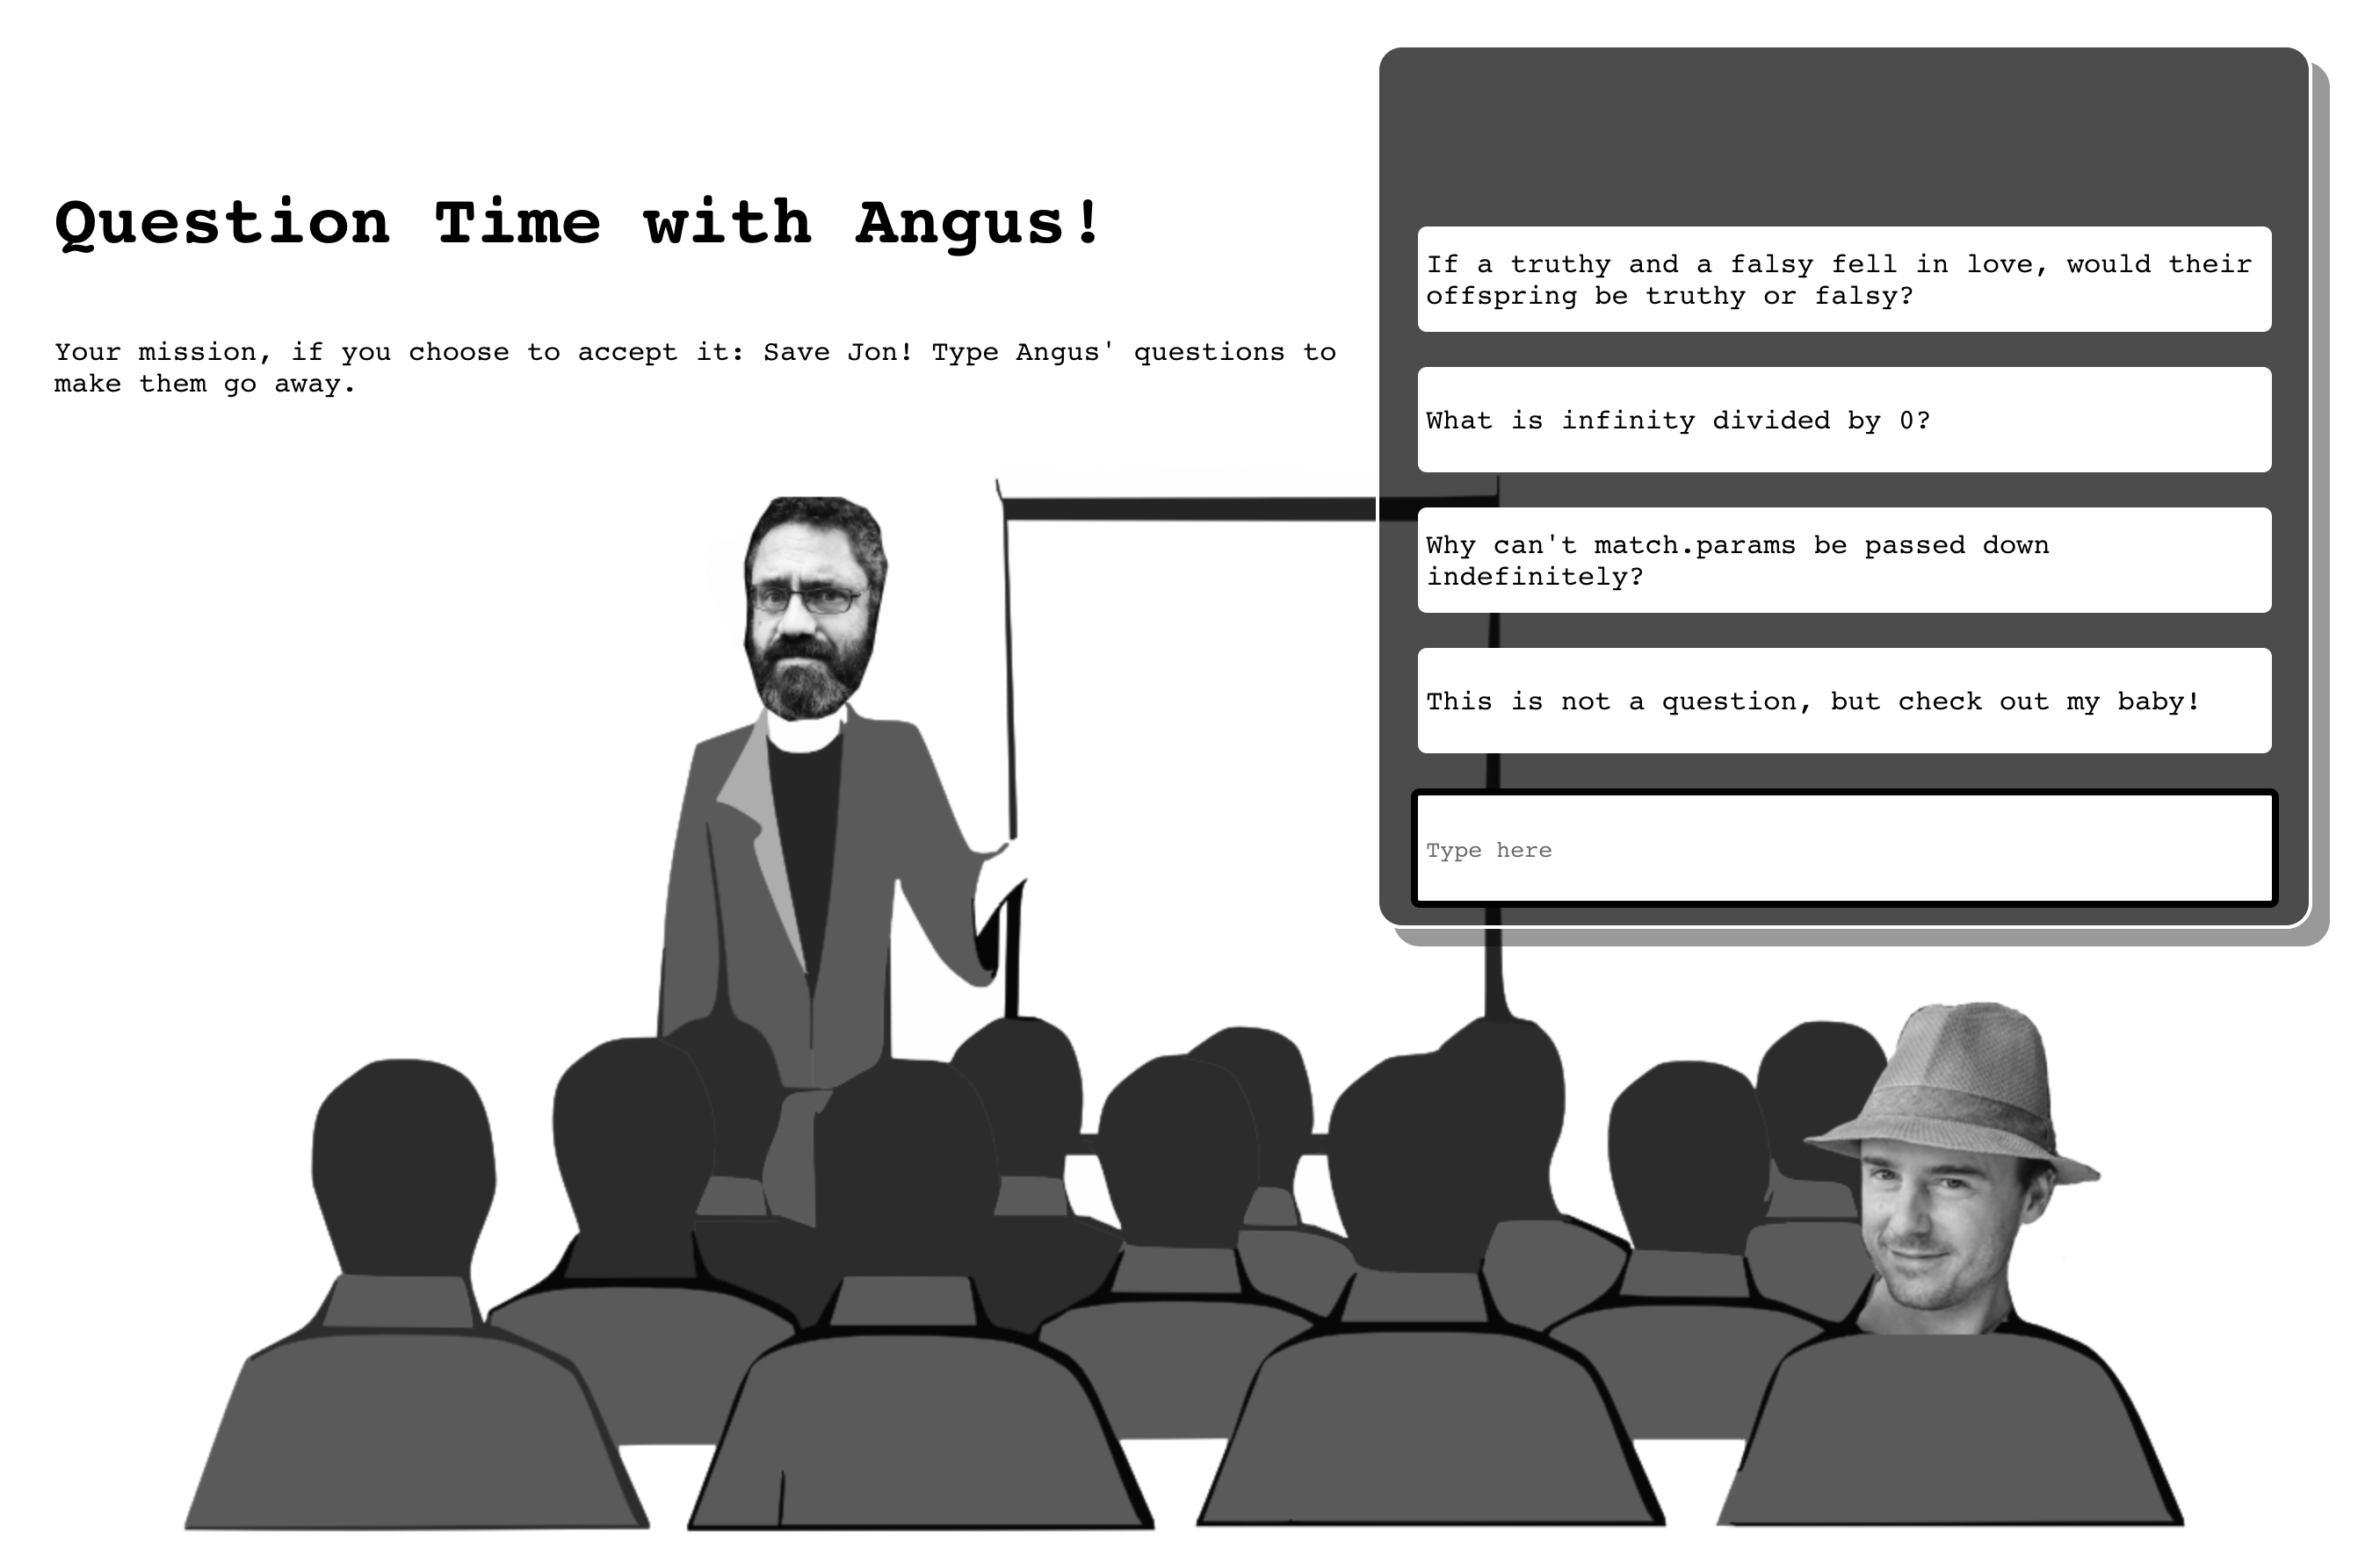
Pair Programming

Slide 4
The Successes
What went well? What did you knock out of the park?
-Trying new ideas.
-Pushing forward.
-Pair-programming.

Slide 5
The Challenges
What didn’t go so well? What did you learn as a team?
-Start Button
-Chose your Educator
-Aspirational features:
--Eg. Making the educators head spin when you lose
because there's too many questions.
--Google slides not working. This is Apache OpenOffice.

Slide 6
Pair Programming
3 minute
Demo
And this is not up on Netlify to
protect Angus' and Jon's identity.

